Slide 1



PhoSim-NIRCam
Jacob Magnusson
Mentors: Dr. Eiichi Egami and Dr. Kevin Hainline
University of Arizona, Steward Observatory
17 April 2021

Slide 2
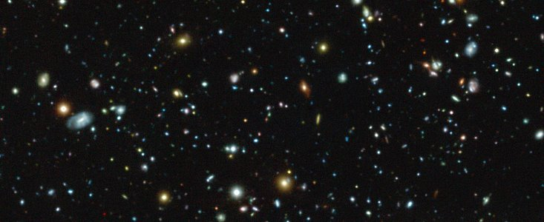
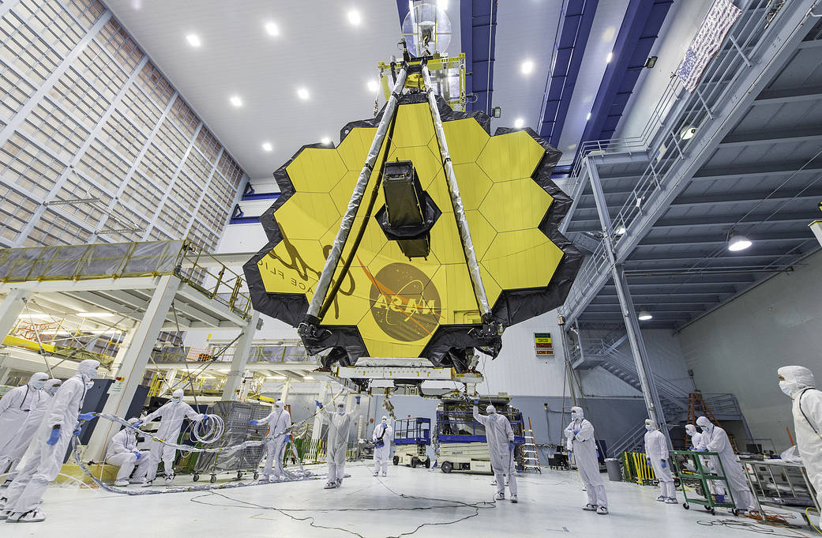
JWST-NIRCam
Image credit: ESO
JWST
James-Webb Space Telescope
Successor to Hubble
Unique Mirror (Effect on image)
NIRCam
Near Infrared Camera
Detector on JWST
Designed to view extremely distant objects
Image credit: NASA/Desiree Stove

Slide 3
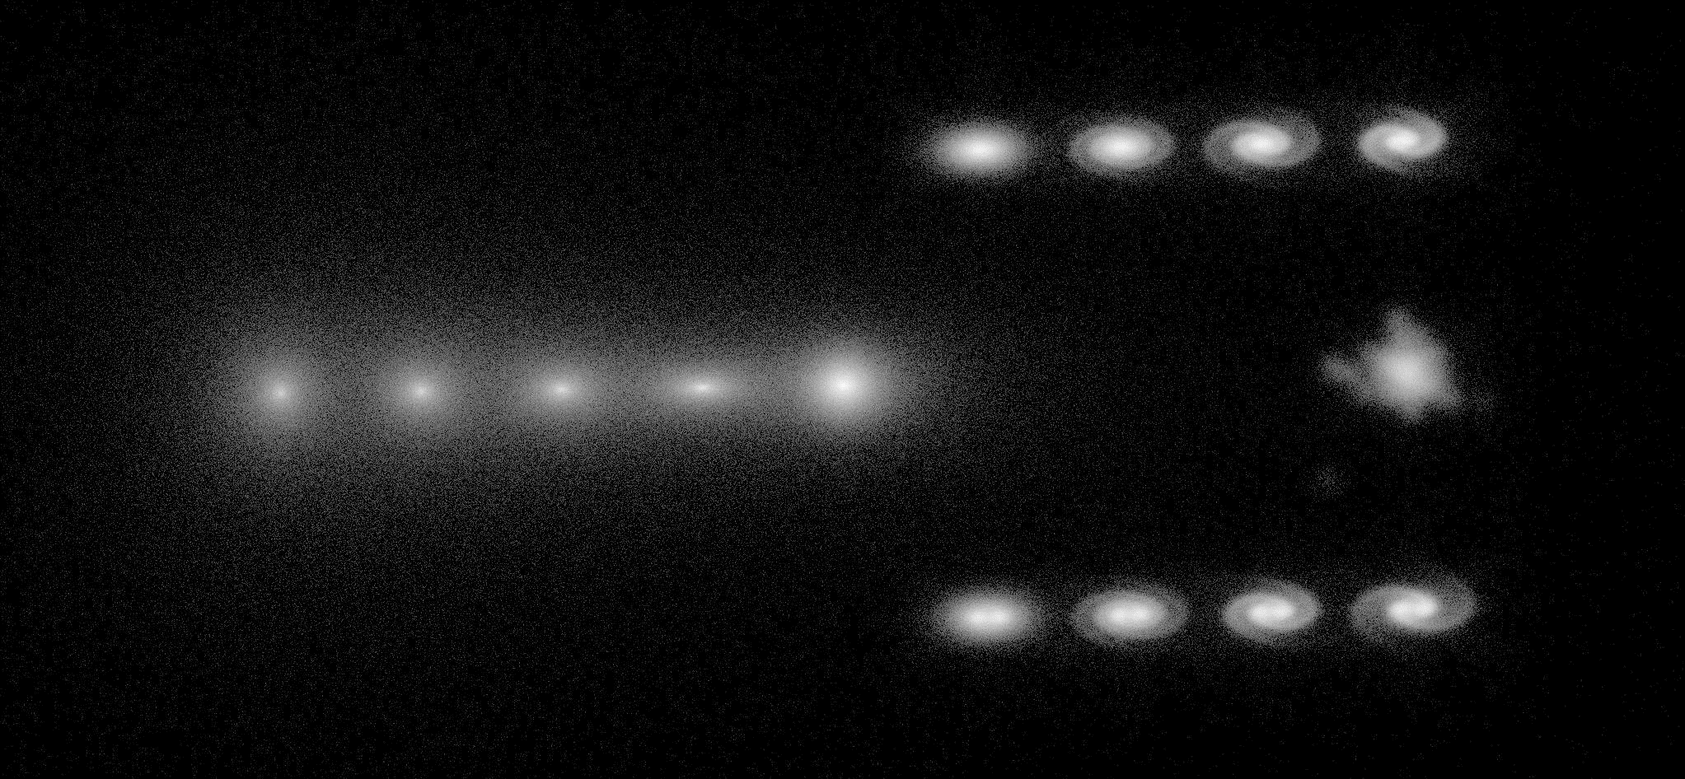
What Makes PhoSim Unique?
Why do we need to simulate these images?
Keyword: Monte Carlo Photon Ray-Tracing ~ Tracking Light Paths
Notes:
3 simulators: PhoSim, Guitarra and Mirage

Slide 4

Detector Calibration
Zero Point Magnitude
  Convert Counts to Flux
  Convert Flux to Object Properties
Geometric Distortion
  Optical System can offset an object
  Polynomial Fitting
Notes:
Misleading data
Zero-point magnitude is a magnitude brightness that corresponds to 1 detector count. So, this is a measure of the total system sensitivity (telescope+instrument, in this case, NIRCam). This is not the magnitude of the faintest source we can detect. The real data will contain a number of background photons coming from the sky and telecope, and if this background generates 100 counts in a given photometry aperture, we would need a source flux of 50 counts to detect it at 5 sigma (1 sigma = sqrt(100) = 10).

Slide 5
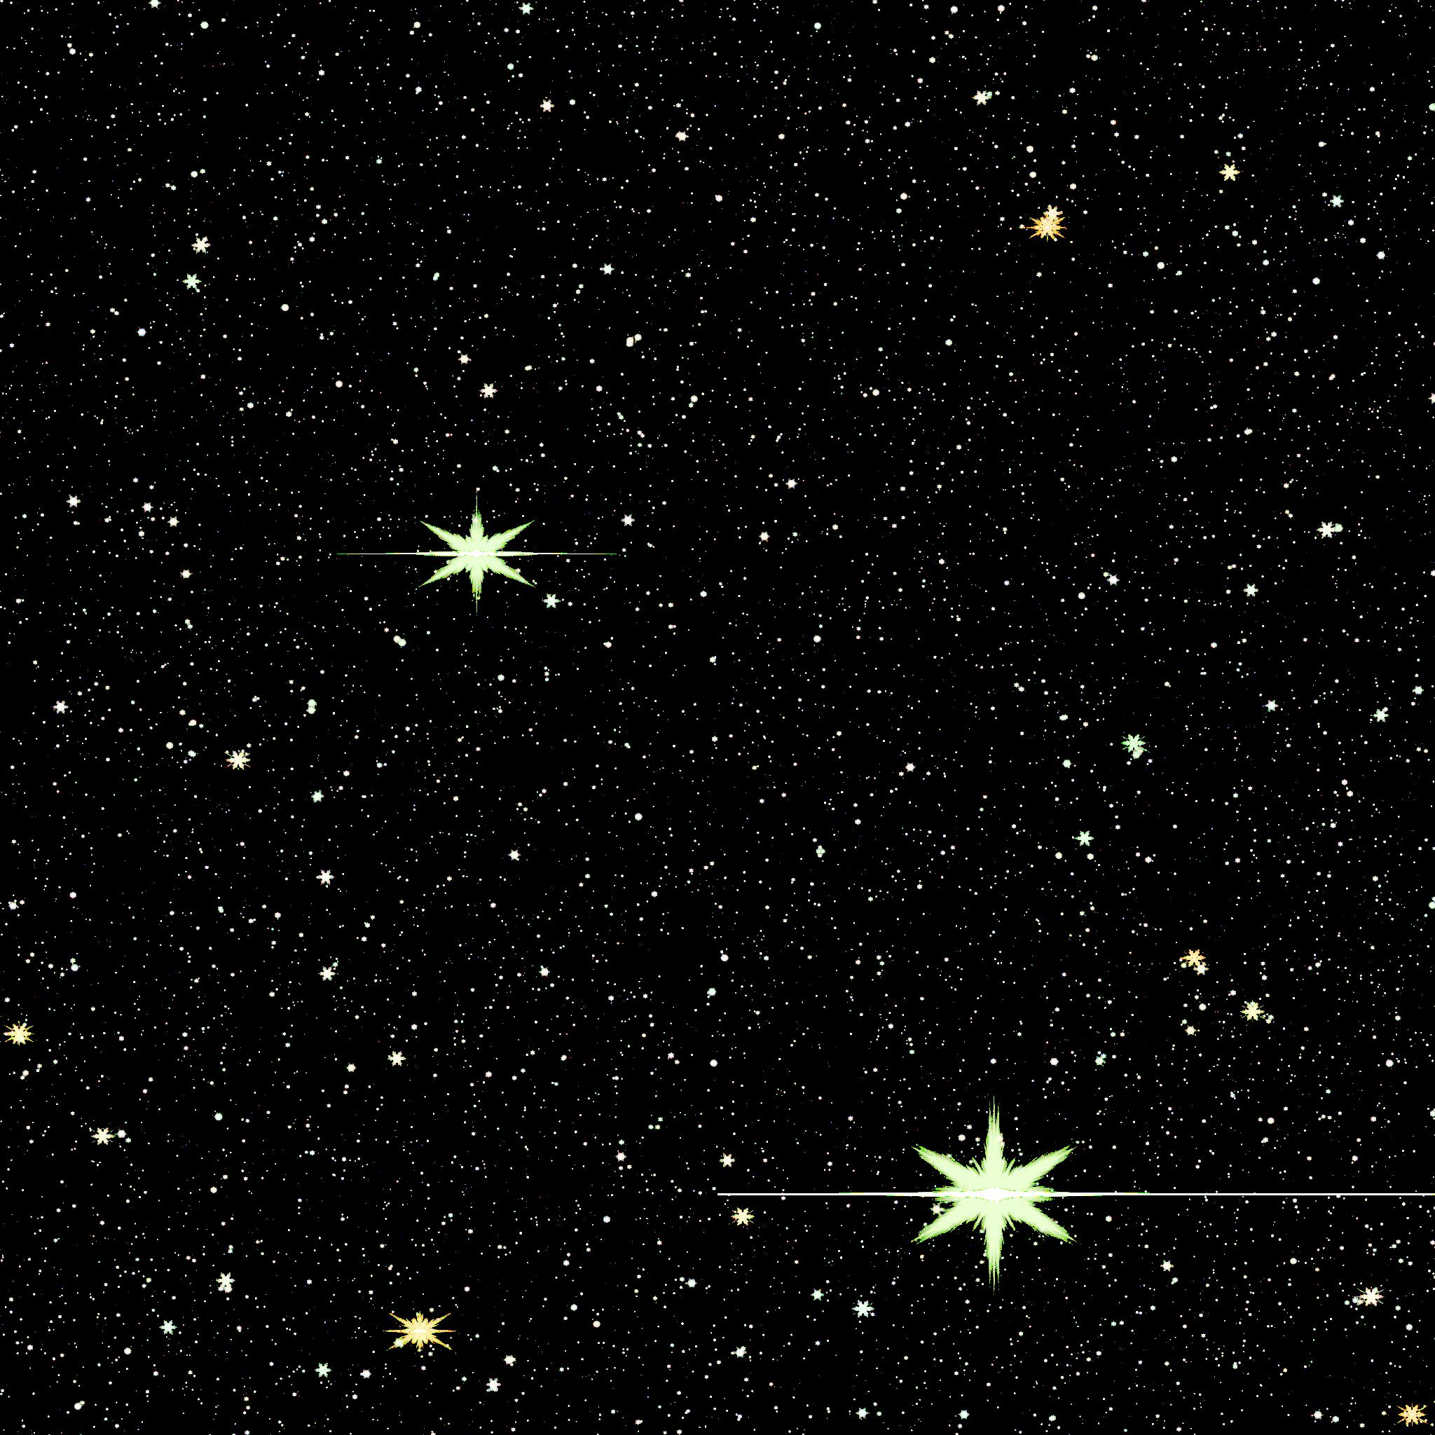
The LMC
(Large Magellanic Cloud)
Satellite Galaxy to the Milky Way
Homogenous distribution of stars with well known positions
A perfect candidate for geometric distortion calibration
The three simulators’ roles
5

Slide 6
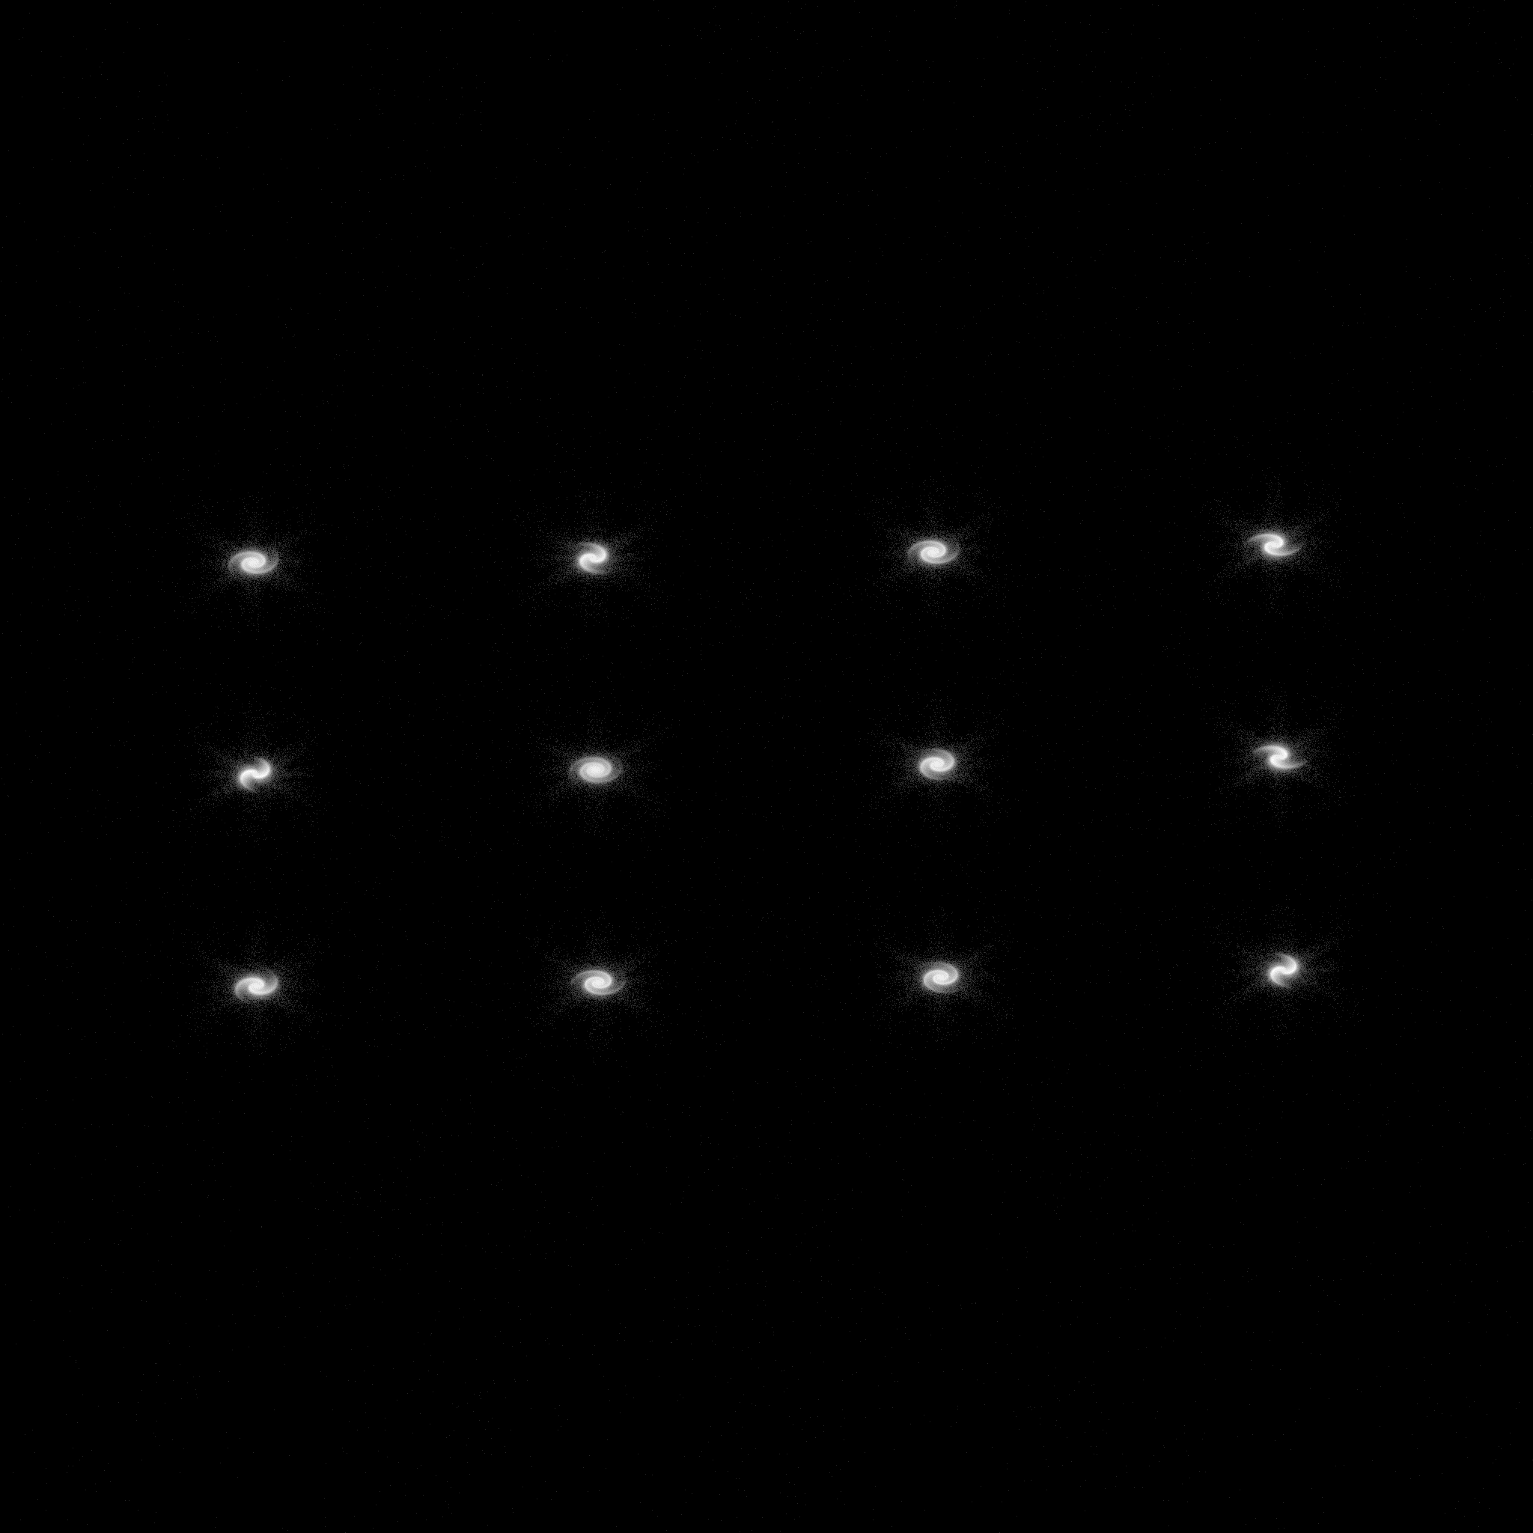
Complicated Structure
Inspired by JAGUAR – 173130 (z = 3)
JADES Extragalactic Ultra-deep Artificial Realization

Slide 7

Conclusions and Future
Zero-Points
PhoSim is less sensitive compared lab measurements
Consistent between the two modules within PhoSim
Geometric Distortion
Header issues in .fits files
STScI geometric distortion fitting program
Deep LMC or high redshift exposures (long runtimes ~ twelve hours)
Filter | Zero Point Magnitude A | Zero Point Magnitude B | ETC Zero-Points A
F070W | 26.019 | 26.014 | 27.014
F090W | 26.736 | 26.736 | 27.431
F115W | 28.844 | 26.840 | 27.543
F150W | 27.210 | 27.206 | 27.782
F200W | 27.433 | 27.434 | 27.956
F277W | 27.295 | 27.461 | 27.862
F335M | 26.327 | 26.401 | 27.033
F356W | 27.392 | 27.415 | 27.981
F410M | 26.646 | 26.528 | 27.154
F444W | 27.476 | 27.245 | 28.029

Slide 8
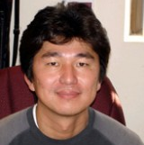


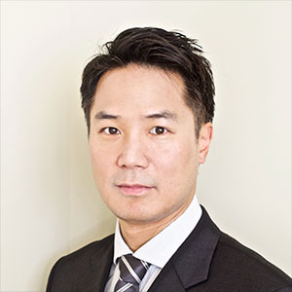
Acknowledgements
Eiichi Egami
Mentor
Kevin Hainline
Mentor
John Peterson
PhoSim Developer
Tony Sohn
STScI Contact

Slide 9
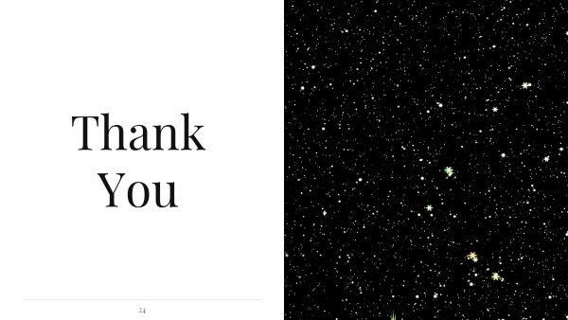
Thank You
Jacob Magnusson
magnussonm0@email.arizona.edu

